Slide 1
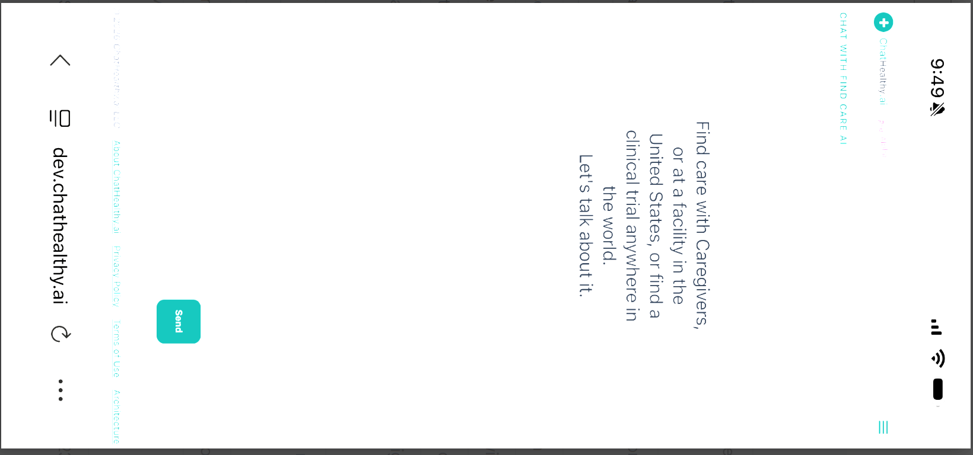
Home Page: Smart Phone web interface Does not apply to web interface
Move Links to menu, Keep copyright at bottom of page
Add all the links on the bottom and top to the menu. Make the ChatHeallthy Logo 10% bigger with the ‘preAlpha label

Slide 2
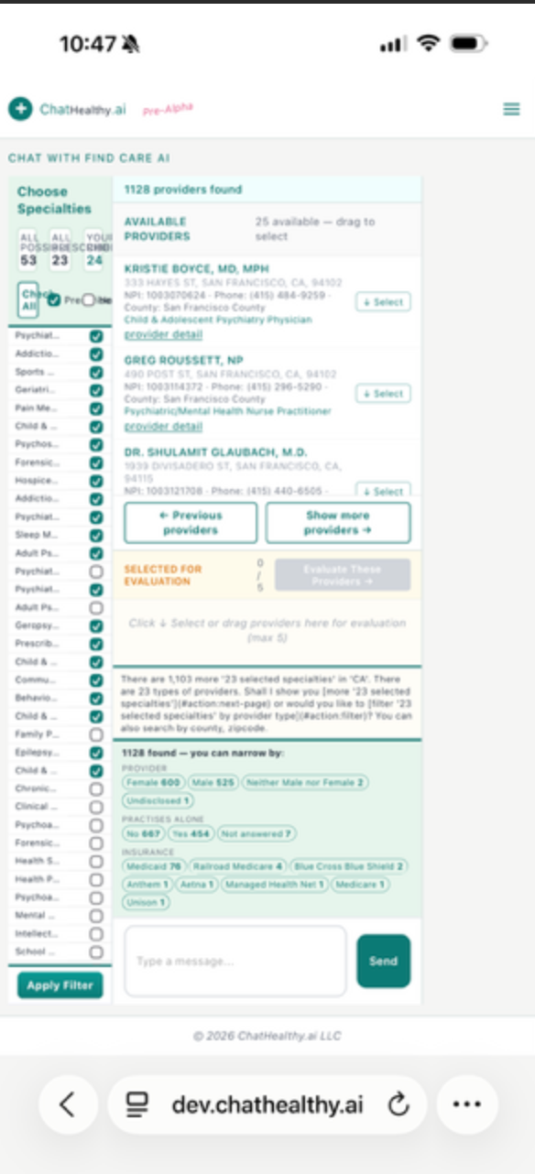
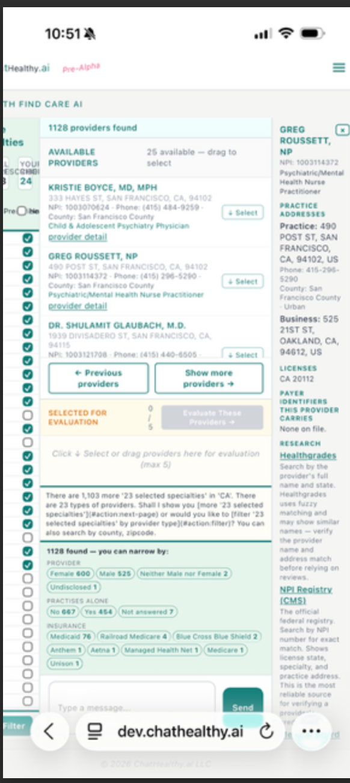
Find an individual provider
Add links to the panels at the top of the menu:
Provider list= center
Specialty Filter is left
Provider detail is right (only visible if a detail is selected)
This is just a button that pops up this dialogue and operates on the list in real time. Thus, returning this vertical space to the list and selector.
Paint the lines in between the vertical panels and allow a user to swipe left or right to expose the panels
Center Panel, left panel specialty choices, Right panel if a detail has been selected detail. The idea is that a user can swipe between panels. And

Slide 3
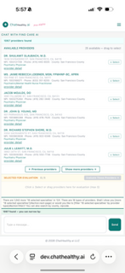
How to handle the filter screen on the phone.
The display of the filter in the web version is perfect, except that it must be in a popup. So all this rhetoric is not to be there. This box is to be as thin vertically as possible while containing a button that a human can push with their fingers. When they do the web interface with the circles a user can manipulate that change the query in real time, that is what pops up, Of course on the upper right is an X to close the popup.

Slide 4
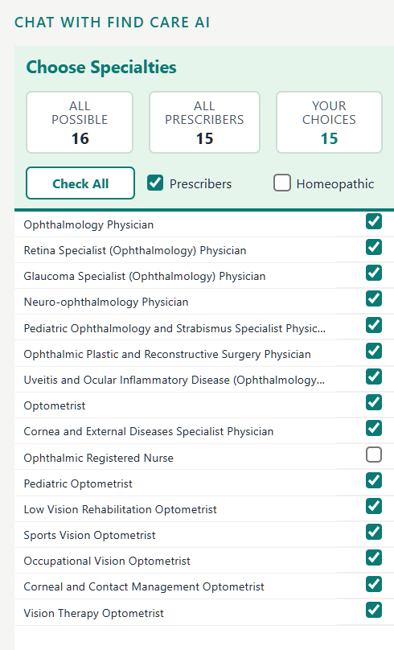
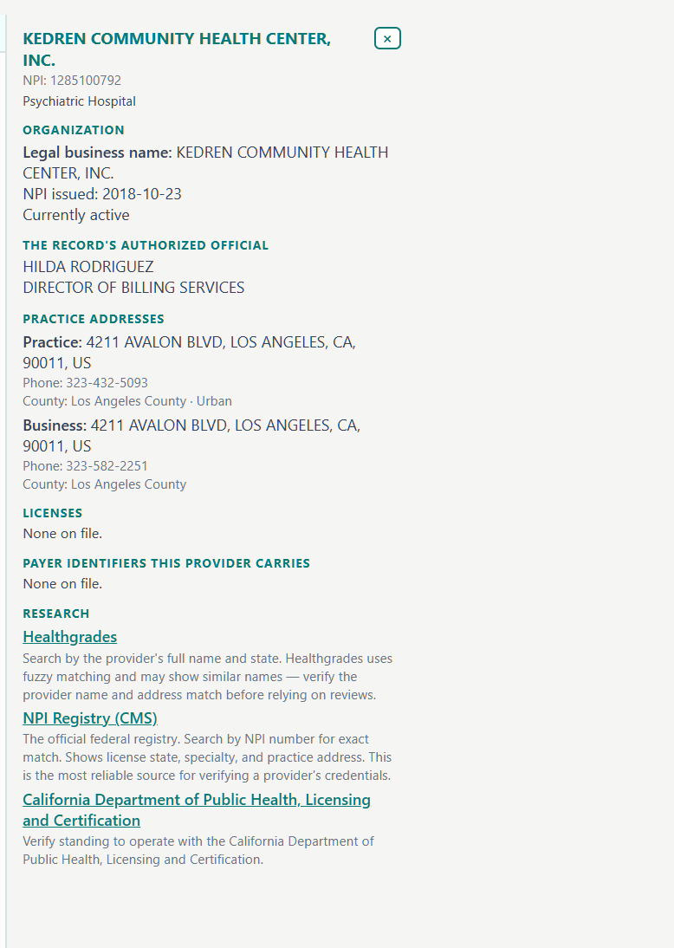
Facility
Choose Facility Type
All Possible, Ambulatory, In patient, Your choice
Ambulatory, Psychiatric, Inpatient (check boxes)
Check all same
Same
Keep the research header Empty on next iteration
Delete these links
Research coming

